Slide 1

Building IoT Solutions:
A Hands-On Exploration of Hardware and Connectivity"
Dr. D. Ramesh Reddy,
Assistant Professor,
Department of ECE,
VNR VJIET

Slide 2
Introduction
IOT Comprises “Things” with Unique ID and Connected to Internet.
Focus is Configuration, Control and Networking Via the internet of Devices or “Things”.
Revolution of Capabilities (Communications, Networking and Cloud Technologies) at the End Points (Things).
Experts forecast by 2020 around 50 billion devices connected to Internet.
Scope is not just limited to connecting things to internet.
Allows things to communicate and exchange data.

Slide 3
Introduction
IOT Comprises “Things” with Unique ID and Connected to Internet.
Focus is Configuration, Control and Networking Via the internet of Devices or “Things”.
Revolution of Capabilities (Communications, Networking and Cloud Technologies) at the End Points (Things).
Experts forecast by 2020 around 50 billion devices connected to Internet.
Scope is not just limited to connecting things to internet.
Allows things to communicate and exchange data.

Slide 4
Introduction
Data : Raw and Unprocessed Data
Information: filtering, Processing, Categorizing, Condensing data
Knowledge: Organizing and Structuring information
Ex: Data (72,45,600,21082020,XX,YY); (84,56,XX,YY,ZZ)
Information: Temperature 72, Humidity 45, Time 6:00 , Date : 21:08:2020.
Average temperature of the day is 70.

Slide 5
Introduction
IOT Based Water Quality Monitoring
Data : Raw and Unprocessed Data
Node-1 (7,2000,23.5,6) Node-2 (2,1000,25.07,10)
Information: Processing the Data.
Node 1: PH:7, Turbidity: 2000 , Temp: 23.5 *c, Salinity: 6 PPM
Knowledge: Organizing and Structuring information.
The water at Node-1 is Contaminated.
Sends Request to Node-1 “TURN OF MOTOR”

Slide 6
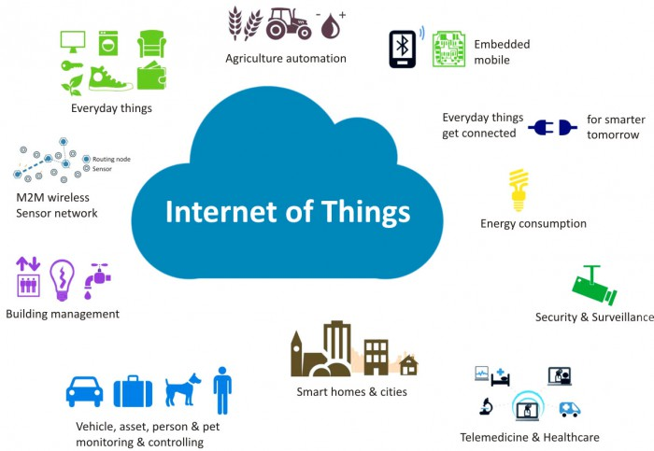
Introduction
Home
Cities
Environment
Energy
Retail
Logistics
Agriculture
Industry
Health and Lifestyle

Slide 7
Definition and Characteristics of IoT
A dynamic global network infrastructure with self-configuring capabilities based on standard and interoperable communication protocols where physical and virtual "things" have identities, physical attributes, and virtual personalities and use intelligent interfaces, and are seamlessly integrated into the information network, often communicate data associated with users and their environments.

Slide 8
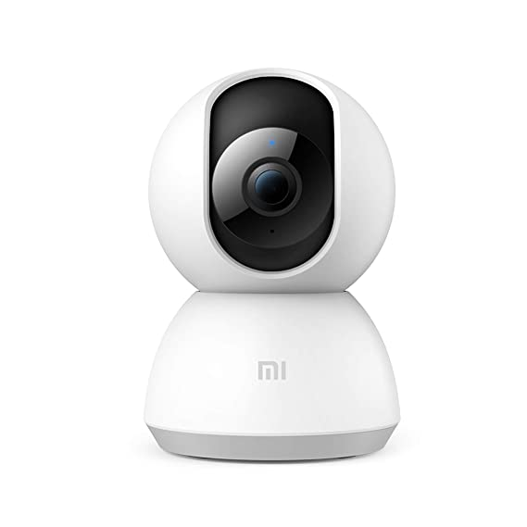
Definition and Characteristics of IoT
Dynamic and Self adapting (Surveillance Camera)
Self Configuring (Weather Monitoring)
Interoperable Communication Protocols
Unique Identity (IP or URI)
Integrated in to Information Network. (Weather Monitoring)

Slide 9
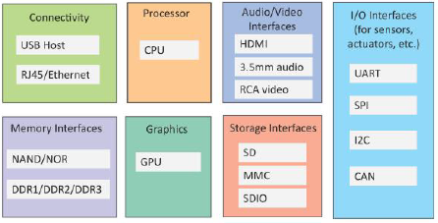
II. Physical Design of IoT
I/O Interface for sensors
Interfaces for Internet Connectivity
Memory and Storage interfaces
Audio/Video Interfaces

Slide 10
II. Physical Design of IoT
IoT devices collect various sensor data from on board or attached sensors – (Temperature, Humidity and Light Intensity).
Sensed data is sent to the other devices or cloud-based storage server/storage.
IoT Devices can be connected to actuators that allow them to interact with other physical entities in the vicinity of device.
Relay connected to device can turn on/off based on commands sent to the IoT device over internet.

Slide 11
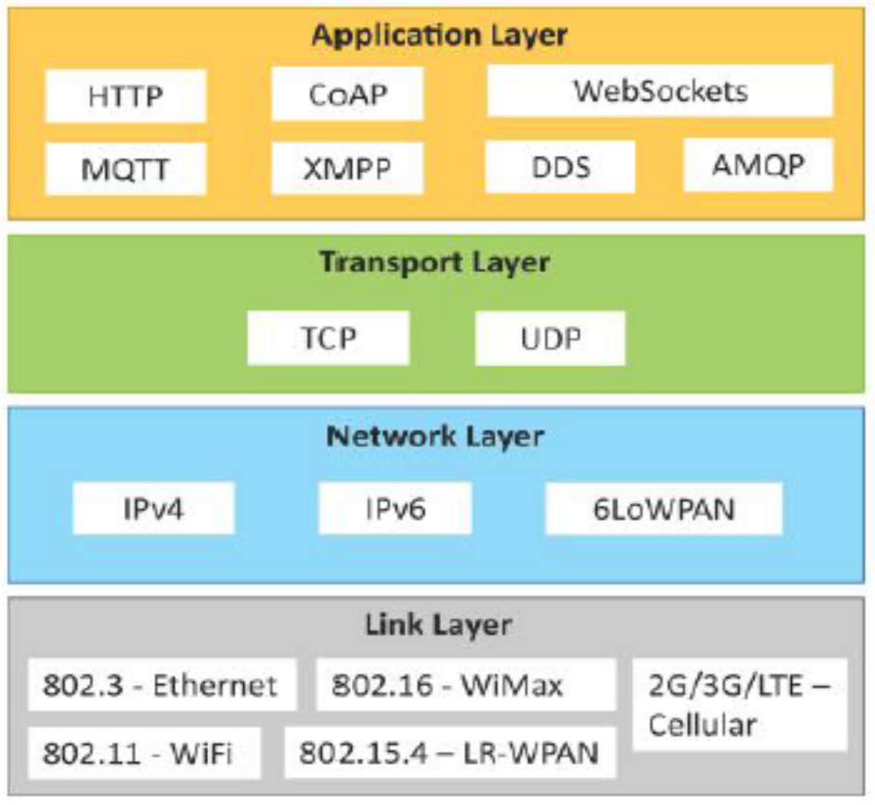
II. Physical Design of IoT
Link layer
  802.3, 802.11, 802.16,802.15.4, 2G/3G/4G
Network Layer
  IPV6, IPV4, 6LoWPAN
Transport Layer
  TCP, UDP
Application Layer
  HTTP, CoAP, WebSockets, MQTT, XMPP, DDS, AMQP.

Slide 12
II. Physical Design of IoT
Data Link layer
  These protocols determine how the data is physically sent over the N/W or Medium (Copper Cable, Coaxial Cable and Radio Waves )
  Scope is limited to Local Network
  Determines how the packet are coded and signaled by the hardware device over medium.
  IEEE 802.3 (Wired Ethernet Standard)
  10 BASE5:- Coaxial cable as a shared medium,
  10 BASE-T(802.3.i) :- Ethernet over copper twisted pair connections
  10 BASE-F (802.3.j) :- Ethernet over Fiber Optic Connection
Data Rates: 10 Mb/sec to 40 Mb/sec --- Data is sent by one and received to all

Slide 13
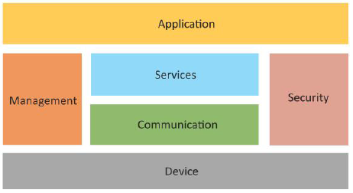
III. Logical Design of IoT

Slide 14
III. Logical Design of IoT
Functional blocks of an IoT
Communication API’s
Provide the system the capabilities for identification, sensing, actuation, communication
Device
Communication
Services
Management
Security
Application

Slide 15
III. Logical Design of IoT
Functional blocks of an IoT & Communication API’s
Device:- IoT system comprises of device provide sensing, actuation, monitoring and control function.
Communication:- This Block handles communication for IoT system. (IPV6, IPV4, MQTT, AMQP, TCP and UDP)
Services:- Service for device monitoring, device control services, data publishing service and services for device discovery.
Management :- It provides various functions to govern the IoT System
Security:- It Securer's IoT system by providing functions such as authentication, authorization, message and content integrity and data security.
Application:- Provide an Interface that the user can use to control and monitor various aspects of IoT system. -.-- View the device, System status and analyze the processed data.

Slide 16
III. Logical Design of IoT
IoT Communication Models
Request Response
Publish Subscribe
Push – Pull
Exclusive Pair

Slide 17
III. Logical Design of IoT
IoT Communication Models
Request Response Communication Model
Client sends request to the server and server responds to the request.
Receives request from client,
process request
fetches resources, prepares response and sends response to client
Sends request to server
Resources
Request
Response
Client
Server

Slide 18
IoT Communication Models
Publish Subscribe Communication model
Consumer:- Subscribe to the topics which are managed by Broker’s.
Broker:-Receives data from Topic from Publishers, Sends data to all the subscribed consumers.
Broker
Sends Message to Topics
Consumer – 1
Pubisher
Topic – 1
Subscribers
Consumer -1
Consumer -2
Consumer – 2
Topic – 2
Subscribers
Consumer -1
Consumer -2
Consumer – 3
Client

Slide 19
IoT Communication Models
Push - Pull Communication model
Data producers push the data to the Queue’s. Consumers pull the data from Queue’s
Producers do no need to be aware of consumer.
Queues help in decoupling the message between producers and consumers.
`Queues act as Buffer:- Situation where there is mismatch between rate at which producers push data and rate at which consumers pull the data.
Sends Message to Queue.
Pubisher
Queue’s
Consumer – 1
Consumer – 2

Slide 20
IoT Communication Models
Exclusive Pair Communication model
Persistent Connection between client and server.
Ones the connection is setup – open until client sends close request.
After connection client and server can send messaged to each other after connection setup.
State full communication model and server is aware of all the open connection.
Client
Request setup connection
Server
Response accepting the request
Message from client to server
Message from server to client
Connection close request
Connection close response

Slide 21
IoT Enabling Technologies
IoT is enabled by several technologies including
Wireless Sensor Networks
Cloud Computing
Big Data Analytics
Embedded System
Security protocols and architecture
Communication protocols
Web Services
Mobile Internet
Semantic Search Engine

Slide 22
IoT Enabling Technologies
IoT is enabled by several technologies including
Wireless Sensor Networks:- WSN comprises of Distributed devices with sensors which are used to monitor the environmental and physical conditions.
WSN Consists of End Nodes, Routers and Coordinator.
End Nodes: Sensors attached to them
Routers: Routers are responsible for routing the data from end nodes to coordinator
Co-Ordinator:- Collect the data from all the nodes. (Act as gateway that connects the WSN to the Internet)

Slide 23
IoT Enabling Technologies
IoT is enabled by several technologies including
Example of Wireless Sensor Networks :-
Weather Monitoring system
Indoor Air quality monitoring system
Soil moisture monitoring system
Surveillance systems use WSN for collecting surveillance data
Smart grids use WSN for monitoring the grid at various points
Structural health monitoring use WSN to monitor the health of structures

Slide 24
IoT Enabling Technologies
IoT is enabled by several technologies including
Cloud Computing : - It is a transformative computing paradigm that involves delivering application and services over the internet.
It involves provisioning of computing, networking and storage resources on demand and providing the resources as metered services to the users. (Pay As You Go) Model
Cloud computing services are offered to users
Infrastructure as a service (IaaS) : Resources provided to the user as Virtual machine, virtual storage.
Platform as a service (PaaS) : Develop and deploy applications in the cloud using development tools, API (Application Program Interface).
Software as a service (SaaS): Provides user complete software application or the user interface.

Slide 25
IoT Enabling Technologies
IoT is enabled by several technologies including
Cloud Computing : - It is a transformative computing paradigm that involves delivering application and services over the internet.
It involves provisioning of computing, networking and storage resources on demand and providing the resources as metered services to the users. (Pay As You Go) Model
Cloud computing services are offered to users
Infrastructure as a service (IaaS) : Resources provided to the user as Virtual machine, virtual storage.
Platform as a service (PaaS) : Develop and deploy applications in the cloud using development tools, API (Application Program Interface).
Software as a service (SaaS): Provides user complete software application or the user interface.

Slide 26
IoT Enabling Technologies
IoT is enabled by several technologies including
Big Data Analysis: - Big data is defined as collections of data sets whose Volume, Velocity (In terms of its temporal variation), Variety is so large that it is difficult to store manage process and analyze the data using traditional data bases and data processing tools.
Examples of IoT Systems
Sensor data generated by IoT Systems ( Ex:- Weather monitoring systems)
Health and fitness data generated by IoT Systems. (Wearable Fitness Bands)
Data Generated by IoT Systems for locating and tracking of vehicles.
Data generated by retail inventory monitoring system

Slide 27
IoT Enabling Technologies
IoT is enabled by several technologies including
Characteristics of Big Data
Volume: No fixed threshold for the volume of data to be considered as big data.
Velocity: How fast the data is generated and how frequently it varies.
Variety: Variety refers to the forms of the data.
Big data comes in different forms such as structured (or) unstructured data.
Data Includes data, image, audio, video and sensor data.

Slide 28
IoT Enabling Technologies
IoT is enabled by several technologies including
Communication Protocols (These protocols form the backbone of IoT System)
Enables network connectivity and coupling to applications.
These allow devices to exchange data over the network
Define data exchange formats, data encoding, addressing schemes for devices and routing of packets from source to destination.
Sequence control (Ordering packets determining lost packets)
Flow Control (Controlling the rate at which sender sending the data)
Retransmission of lost packet.

Slide 29
IoT Enabling Technologies
IoT is enabled by several technologies including
Embedded System
An Embedded system is a computer system that has computer hardware and software embedded to perform specific tasks.
Embedded systems are used for specific task
Key components of embedded system include (Micro Processor / Micro Controller, Memory (RAM, ROM, Cache), Storage (Such as Flash Memory)).
Embedded systems runs on embedded operating system (or) Real time operating system.
Digital watches, Digital Cameras, Vending machines, Home applications (Washing machines)

